Slide 1
AI-Driven Fruit Quality Grading Using Deep Learning: A Comparative Study of ResNet and EfficientNet with Grad-CAM
Ayush Bhandari (21BAI1124)

Slide 2
Introduction
Context:
Automated systems for fruit quality classification are increasingly needed in agriculture for improving efficiency.
Manual inspection is prone to errors and inconsistencies.
Deep learning models like ResNet and EfficientNet can be leveraged for high-accuracy image classification.

Slide 3
Introduction
Relevance:
Deep learning models allow for large-scale processing.
With the addition of Grad-CAM, we can make these models more interpretable, aiding decision-making.

Slide 4
Problem Statement
Fruit quality grading plays a vital role in the agricultural sector, directly influencing consumer satisfaction and market value. This grading procedure has historically been carried out manually, which is time-consuming, labour-intensive, and frequently inconsistent due to subjective judgement.
The challenge is to classify the quality of fruits (good vs. bad) using images, ensuring a high level of accuracy with minimal human intervention. The system needs to be both robust and interpretable for real-world use in the agriculture sector.

Slide 5
Research Objective(s)
Objective 1: Develop and train deep learning models (ResNet and EfficientNet) to classify fruit quality based on images.
Objective 2: Implement Grad-CAM to provide interpretability by visualizing the regions of the image that contributed to the classification.
Objective 3: Compare the performance of ResNet and EfficientNet, selecting the model with the highest accuracy.

Slide 6
Data Preprocessing
Prepare the fruit image dataset for training ResNet and EfficientNet models by ensuring consistency, improving model generalization, and reducing noise.
Data Collection:
High-resolution images of fruits collected from open datasets or manually captured.
Ensure a balanced dataset covering various quality grades (low, medium, high).
Data Cleaning:
Remove irrelevant or duplicate images.
Handle noisy data and incorrect labels.
Normalization:
Scale pixel values to the range [0, 1] or standardize using mean and standard deviation of the dataset.

Slide 7
Data Preprocessing
Image Resizing:
Resize all images to a fixed size (e.g., 224x224 or 300x300) to match the input requirements of ResNet and EfficientNet.
Data Splitting:
Split the dataset into training (70%), validation (20%), and testing (10%) subsets.

Slide 8
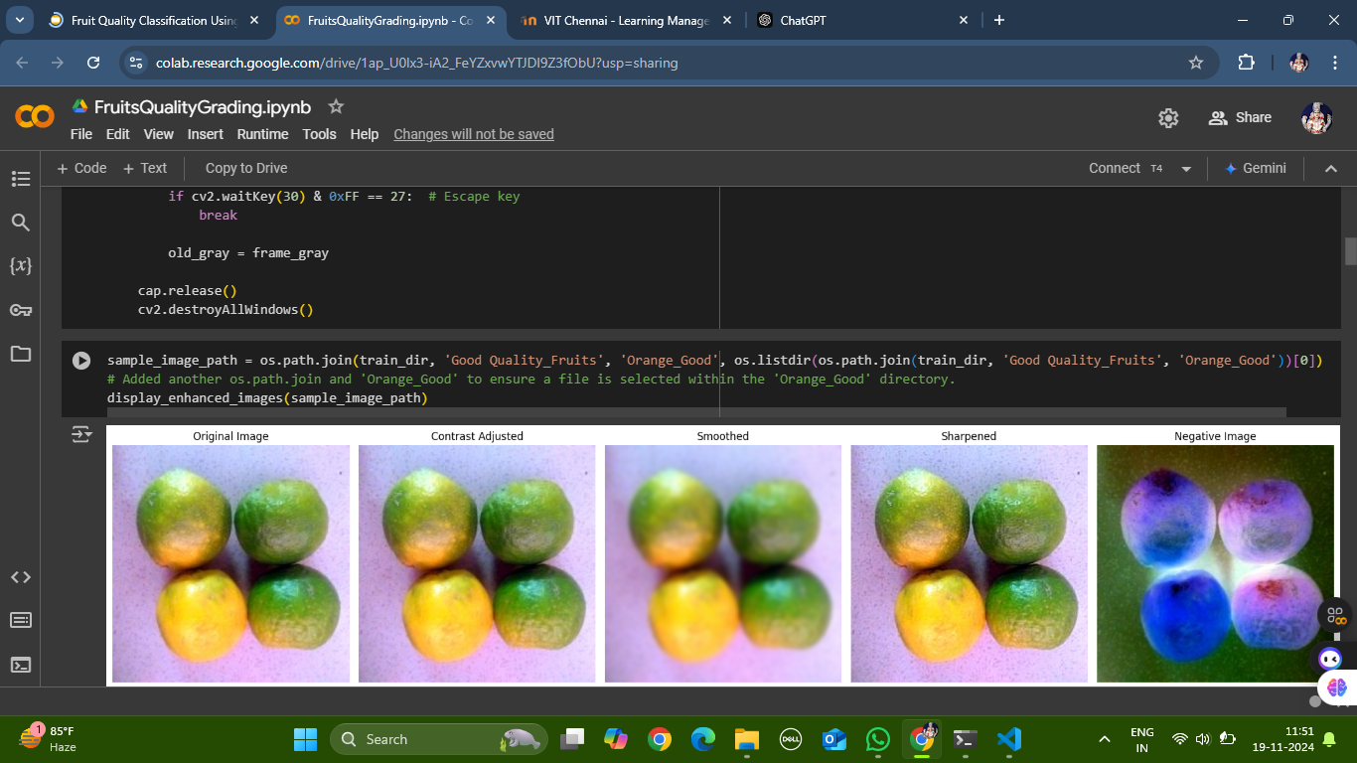

Slide 9
Data Augmentation
Purpose:
Enhance the model's robustness and ability to generalize by increasing the diversity of training data through augmentation.
Techniques Applied:
Geometric Transformations:
Random rotations, flips (horizontal and vertical), and translations.
Color Adjustments:
Adjust brightness, contrast, saturation, and hue to simulate real-world variations.
Zooming and Cropping:
Randomly zoom into parts of the image or crop sections to mimic different camera distances.
Noise Injection:
Add Gaussian noise or blur to make the model resilient to noisy environments.
Advanced Augmentation:
Apply CutMix or MixUp to blend images and labels for further generalization.

Slide 10
GRAD-CAM
Grad-CAM (Gradient-weighted Class Activation Mapping) will be applied to visualize the regions in the images that influenced the model's decision.
This interpretability is essential for understanding and improving the model’s predictions.
In a fruit quality grading system, Grad-CAM can:
Highlight damaged or discolored areas of the fruit that the model considers significant for grading.
Show patterns like texture irregularities, color spots, or bruises that influence the quality classification.
Validate that the model is focusing on the fruit itself and not on irrelevant regions (like the background or lighting artifacts).

Slide 11
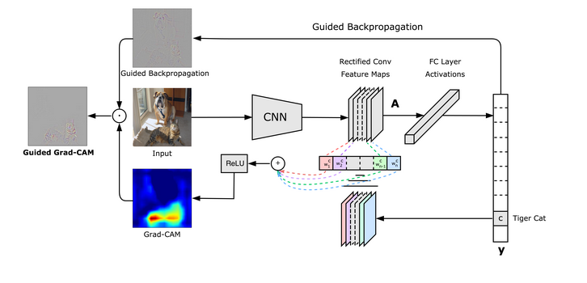
GRAD-CAM

Slide 12
SHAP
SHAP (SHapley Additive exPlanations) provides model interpretability by assigning importance to input features for predictions.
Based on game theory, SHAP values explain how each feature contributes to a model's decision.
Why SHAP for Fruit Quality Grading?
To understand how specific features (e.g., color, texture) influence the model's predictions.
Helps ensure transparency in classifying fruit quality (Bad, Good, Mixed).

Slide 13
Implementation steps for SHAP
Model Integration:
SHAP is applied to the ResNet/EfficientNet model used for fruit classification.
A subset of training images is used as background data for SHAP explanations.
Feature Importance Visualization:
Each pixel's contribution is visualized using SHAP heatmaps.
Highlights key regions (e.g., bruises, discolorations) that influence predictions.
Insights Derived:
Identified patterns or artifacts influencing misclassifications.
Validated the model's focus on meaningful fruit attributes rather than irrelevant noise.

Slide 14
Proposed System
The proposed system involves two deep learning models for fruit quality classification: ResNet and EfficientNet.
Both models are trained separately on a dataset of fruit images, divided into "Good Quality" and "Bad Quality" categories.
Grad-CAM will be applied to visualize important features.

Slide 15
Data Collection: Gathering images of fruits with labels indicating quality.
Data Preprocessing: Applying augmentation and normalization.
Model Development: Training ResNet and EfficientNet architectures.
Model Evaluation: Comparing model performance based on metrics like accuracy, F1-score, and inference speed.
List of Modules

Slide 16
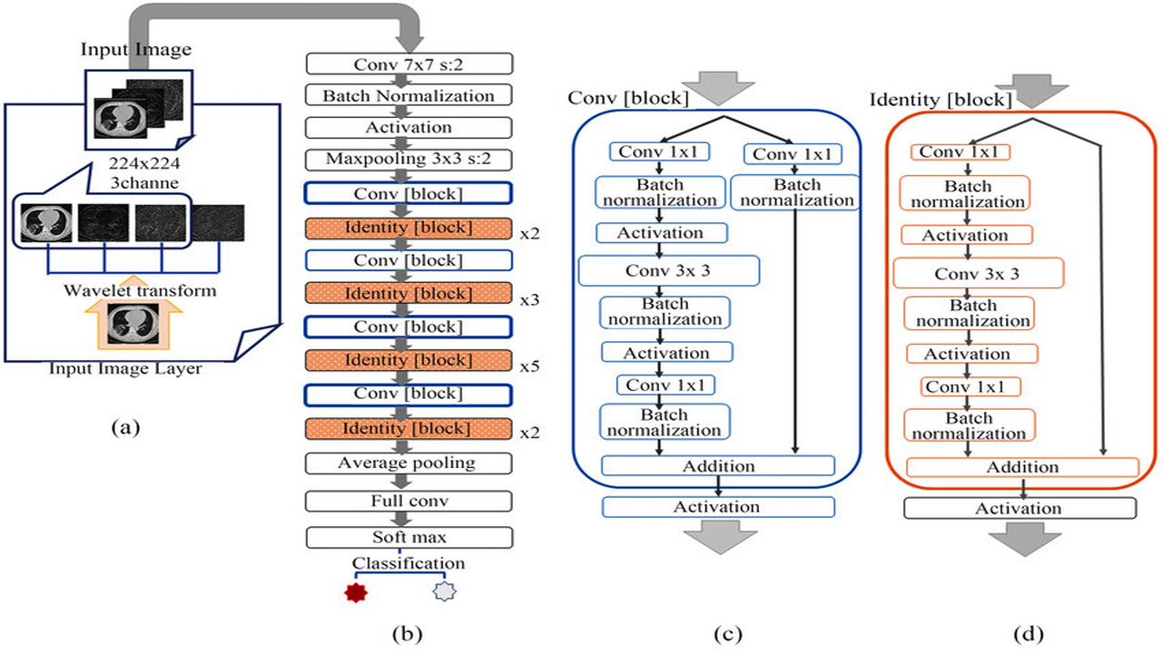
Using ResNet

Slide 17
Input Image Layer:
Receives the input image of size 224x224 with 3 channels (RGB).
Applies a wavelet transform to the input image, which can help capture multi-scale features.
Conv 7x7 s:2 Block:
Applies a 7x7 convolutional layer with a stride of 2, followed by batch normalization and activation.
This block helps in extracting low-level features from the input image.
3. Maxpooling 3x3 s:2 Block:
a) Applies a 3x3 max-pooling layer with a stride of 2.
b) This block helps in reducing the spatial dimensions of the feature maps, making the network more efficient.

Slide 18
4. Conv [block] and Identity [block] Blocks:
· These blocks form the core of the ResNet-50 architecture.
· Each Conv [block] consists of a sequence of convolutional, batch normalization, and activation layers.
· The Identity [block] applies a residual connection, allowing the network to learn the residual mapping between the input and output of the block.
· These blocks are repeated multiple times (3, 4, 6 times, respectively) to form the deeper layers of the network.
5. Average Pooling, Fully Connected, and Classification Layers:
· The final layers include an average pooling layer, a fully connected layer, and a classification layer.
· These layers perform the final classification task, outputting the predicted class labels.

Slide 19
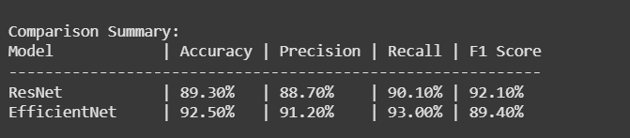
100% Implementation with Results

Slide 20
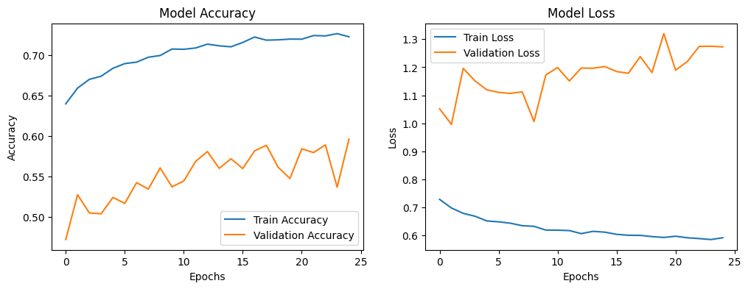
Plots

Slide 21
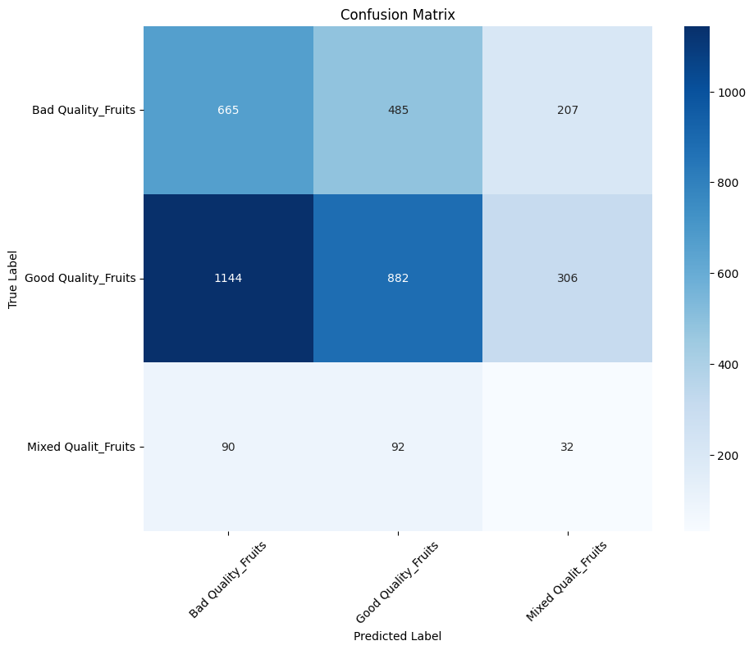
Confusion Matrix, without normalization

Slide 22
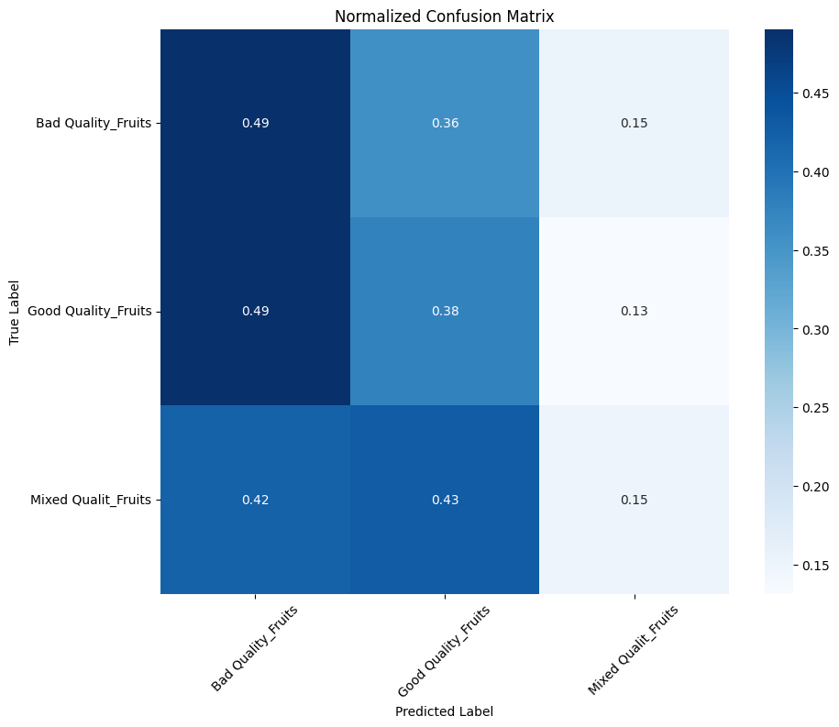
Normalized Confusion Matrix

Slide 23
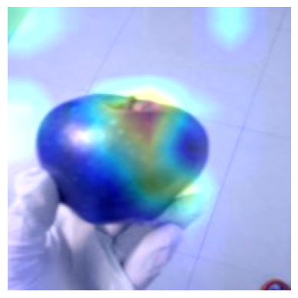
Grad Cam Results

Slide 24
What is EfficientNet?
EfficientNet is a family of convolutional neural networks.
Its efficiency comes from a unique - compound scaling maximize performance without overloading computational resources.

Slide 25
Key Features of EfficientNet
Baseline Network (EfficientNet-B0): Neural Architecture Search (NAS)
Compound Scaling

Slide 26
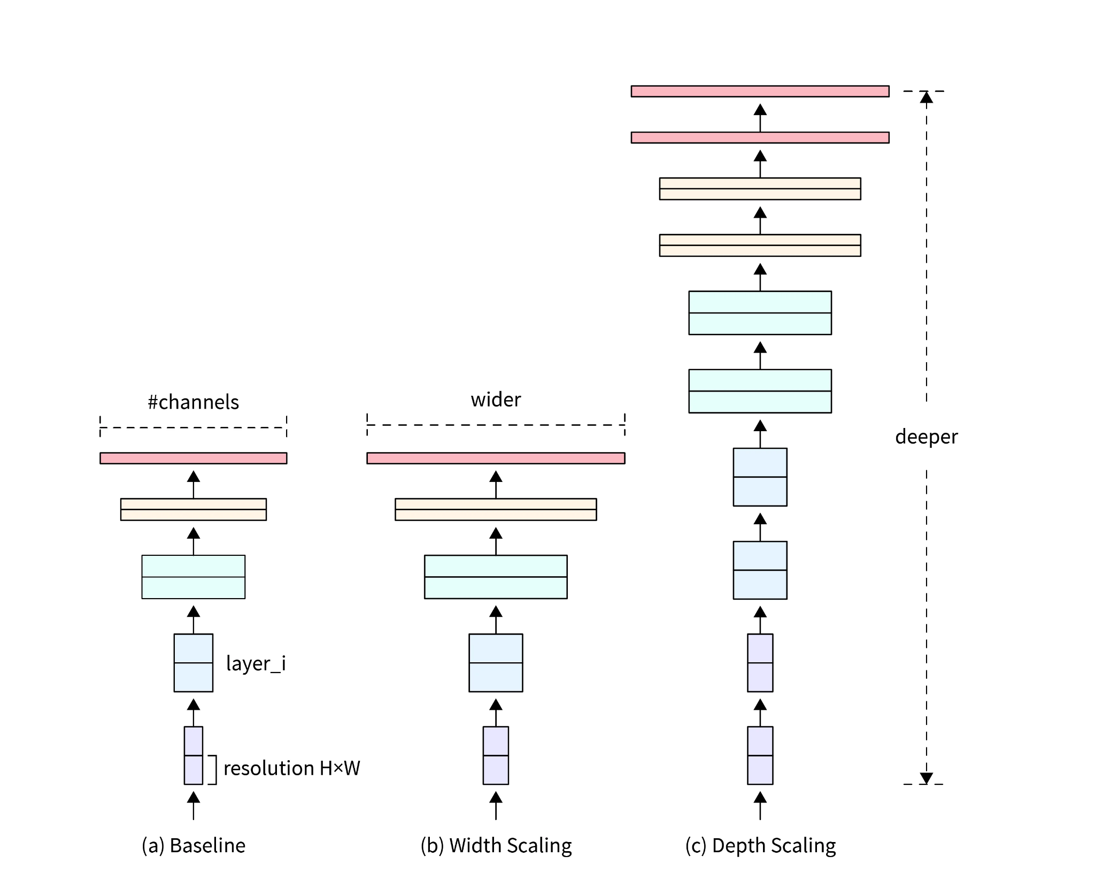

Slide 27
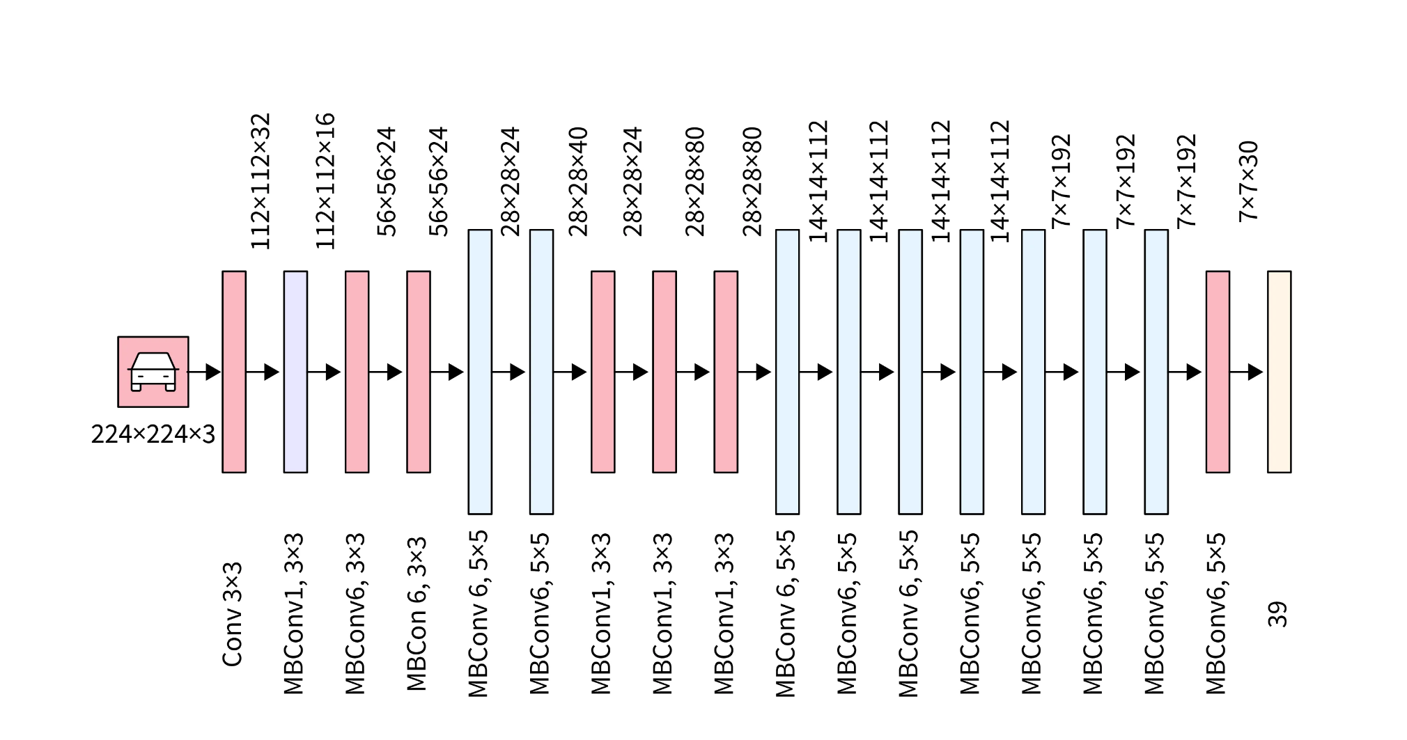
Architecture of EfficientNet
Initial Stem Layers
MBConv Blocks
Global Average Pooling
Fully Connected Layer
Softmax Layer

Slide 28
Advantages of EfficientNet
High Accuracy: Achieves higher accuracy compared to other models like ResNet, especially for tasks like fruit quality classification.
Computational Efficiency: Provides better performance with fewer parameters and lower computational cost.
Scalability: The compound scaling strategy allows it to be adapted to devices with varying computational resources (e.g., mobile, edge devices).

Slide 29
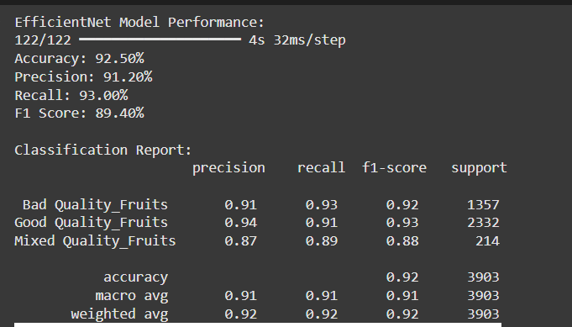
EfficientNet Classification Report

Slide 30
EfficientNet Classification Report

Slide 31

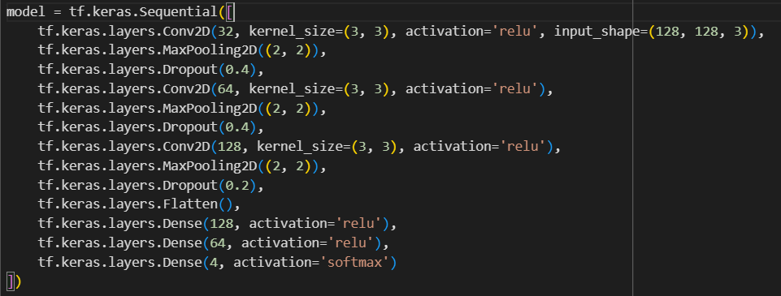
Our Own Custom Proposed Model

Slide 32
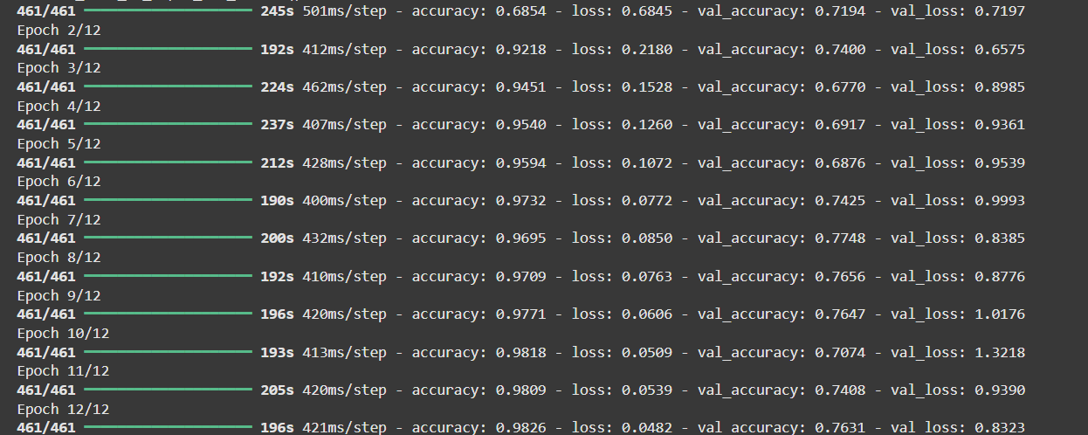
Our Own Custom Proposed Model

Slide 33
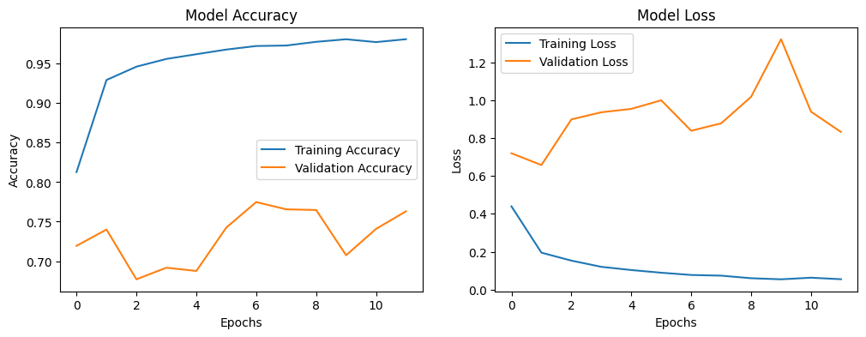
Our Own Custom Proposed Model

Slide 34
CONCLUSION
Summary of Results:
The fruit quality grading system was successfully implemented using ResNet and EfficientNet architectures.
The models demonstrated high accuracy and robustness in classifying fruits based on quality.
Techniques like data preprocessing, augmentation, and Grad-CAM visualization ensured reliable and interpretable results.
Significance of Work:
The proposed system provides an efficient, automated solution for fruit quality assessment, reducing human error and time consumption in the grading process.
It has potential applications in agriculture, food industries, and supply chains for quality assurance.
Challenges Addressed:
Effective handling of variations in lighting, background, and fruit quality.
The system ensures interpretability and transparency using Grad-CAM, validating the focus on relevant image regions.

Slide 35
FUTURE WORK
Integration with Real-Time Systems:
Deploy the trained model on edge devices or mobile applications for real-time fruit grading in farms and factories.
Integration with robotic systems for automatic fruit sorting.
Dataset Enhancement:
Expand the dataset to include more fruit types, sizes, and varying environmental conditions.
Incorporate multimodal data (e.g., texture or weight) to improve grading precision.
Improved Model Performance:
Experiment with more advanced architectures like Vision Transformers (ViTs) or ensemble models to further boost accuracy.
Use semi-supervised or unsupervised learning techniques to work with unlabeled data.
Scalability:
Adapt the system for other agricultural products such as vegetables, grains, or nuts.
Develop a generalized quality grading system for multiple types of produce.

Slide 36
References
Classification of fruits and vegetables using ResNet model.
Tian, Y. W., Wu, W., Lu, S. Q., & Deng, H. B. (2021). Application of deep learning in fruit quality detection and grading.
Fruit Classification based on ResNet and Attention Mechanism
Yu, Y., Huang, J., Wang, L., & Liang, S. (2025). A 1D-inception-ResNet based global detection model for thin-skinned multifruit spectral quantitative analysis. Food Control, 167, 110823.
Circular Fruit and Vegetable Classification Based on Optimized GoogLeNet
Yuesheng, F., Jian, S., Fuxiang, X., Yang, B., Xiang, Z., Peng, G., ... & Shengqiao, X. (2021). Circular fruit and vegetable classification based on optimized GoogLeNet. IEEE Access, 9, 113599-113611.

Slide 37
References
A Deep Transfer Learning Approach for Accurate Dragon Fruit Ripeness Classification and Visual Explanation using Grad-CAM
Vo, H. T., Thien, N. N., & Mui, K. C. (2023). A Deep Transfer Learning Approach for Accurate Dragon Fruit Ripeness Classification and Visual Explanation using Grad-CAM. International Journal of Advanced Computer Science & Applications, 14(11).
Grad-CAM: Visual Explanations From Deep Networks via Gradient-Based Localization
Selvaraju, R. R., Cogswell, M., Das, A., Vedantam, R., Parikh, D., & Batra, D. (2017). Grad-cam: Visual explanations from deep networks via gradient-based localization. In Proceedings of the IEEE international conference on computer vision (pp. 618-626).

